Slide 1

#NoEstimates Focus on what matters

Slide 2





@sretiere
#NWX

Slide 3



Pourquoi vous estimez ?
Donner des dates
Efficacité
Engagement
https://www.flickr.com/photos/regardnumeric/8714417527
https://www.flickr.com/photos/71068385@N02/9248863866
https://www.flickr.com/photos/smemon/6097799975

Slide 4




Donner des dates dans un monde VUCA
Volatility
Uncertainty
Complexity
Ambiguous

Slide 5


Efficace ?
Ou
https://www.flickr.com/photos/bitchymal/5585133308/
https://www.flickr.com/photos/lancey/8712014882/

Slide 6


Engagé ?
Ou
https://www.flickr.com/photos/jhofmann69/4629547971
https://www.flickr.com/photos/cookingforgeeks/3915418027

Slide 7

Au fait on délivre quoi ?
https://www.flickr.com/photos/americanvirus/4368675285

Slide 8

De quoi j’ai vraiment besoin ?
https://www.flickr.com/photos/10413717@N08/14419640541

Slide 9

Avoir des options (de valeur)
https://www.flickr.com/photos/102100216@N05/14268335007

Slide 10

Viser l’efficience
https://www.flickr.com/photos/salvatore_gerace/16975486175

Slide 11

Créer un environnement favorable
https://www.flickr.com/photos/clubsodaguide/31110821900

Slide 12
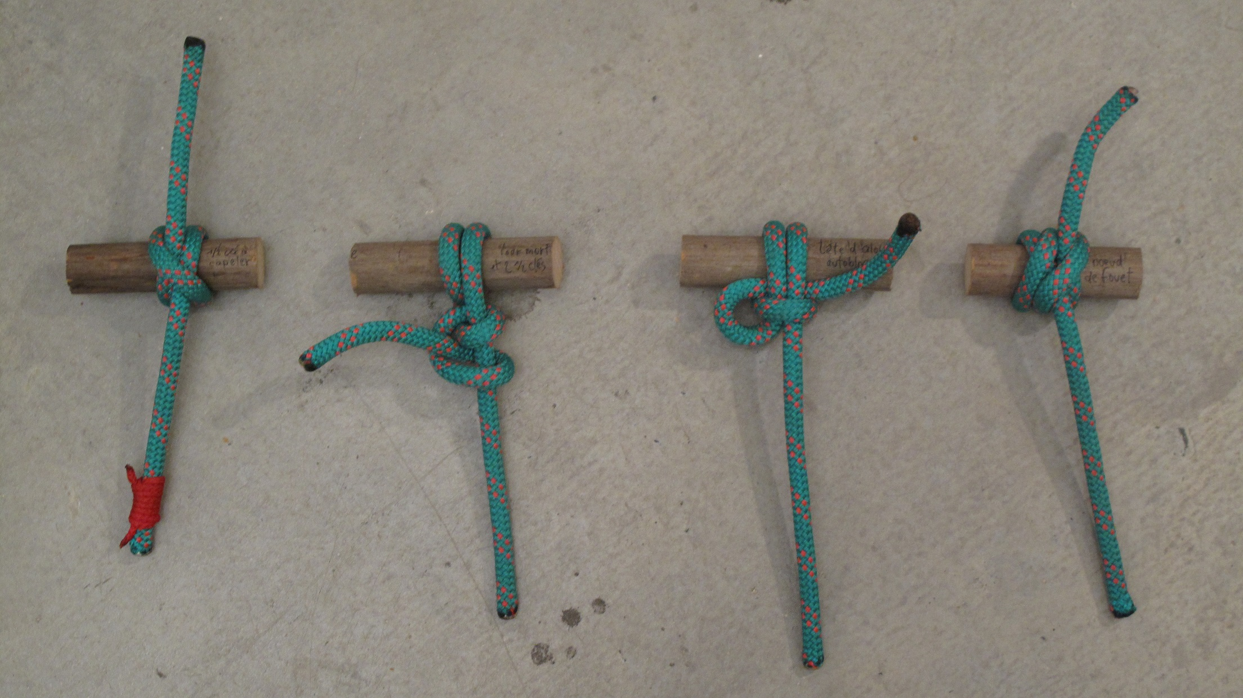
Conclusion
https://www.flickr.com/photos/martingautron/4231577580

Slide 13

Questions ?
https://www.flickr.com/photos/ume-y/6350558244

